Slide 1

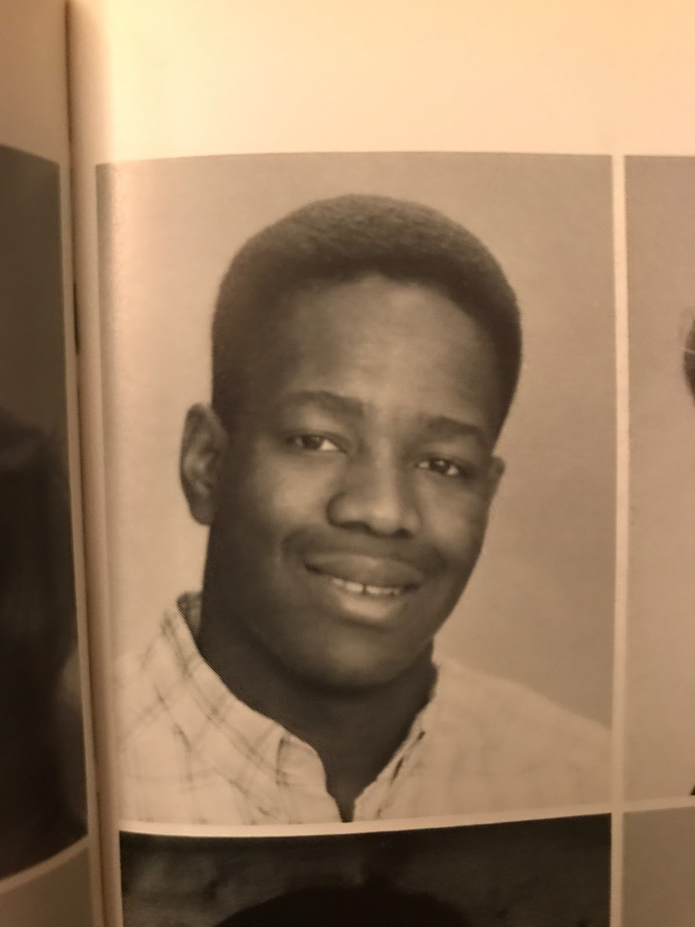
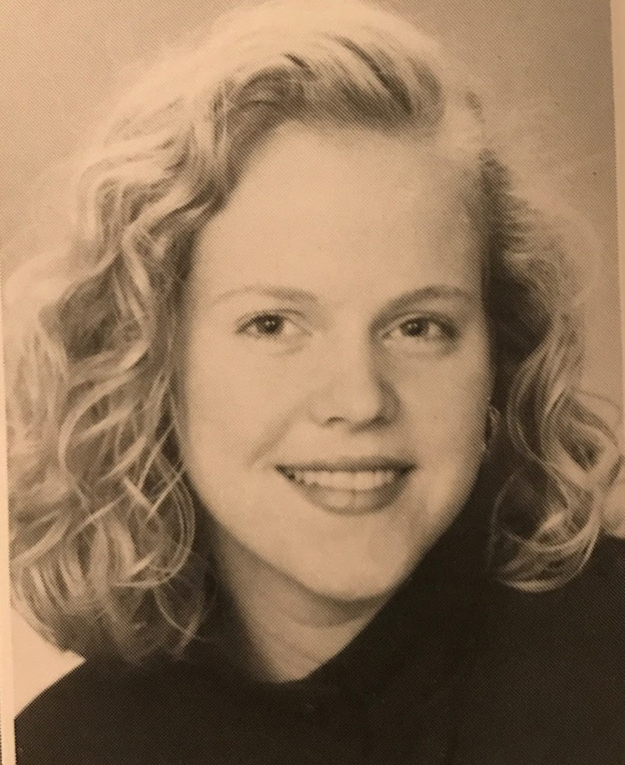
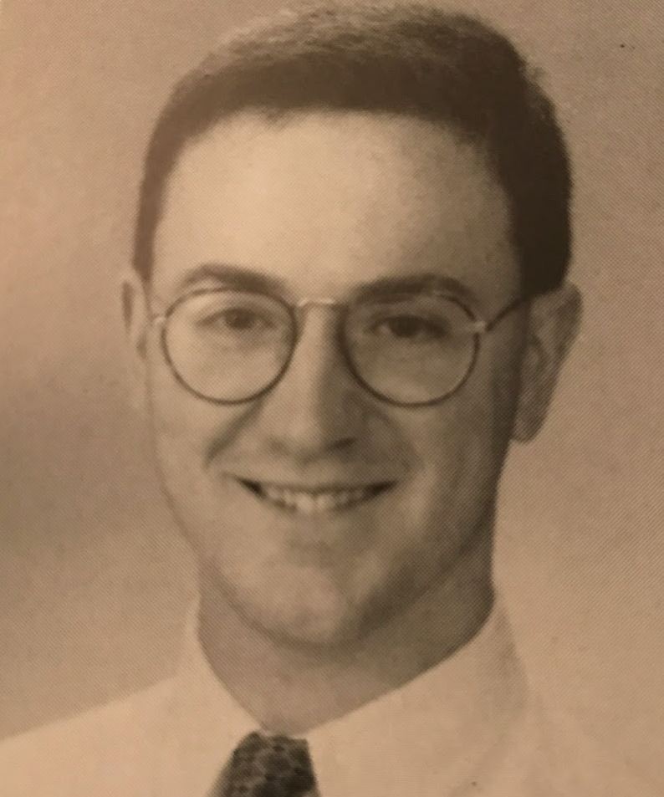
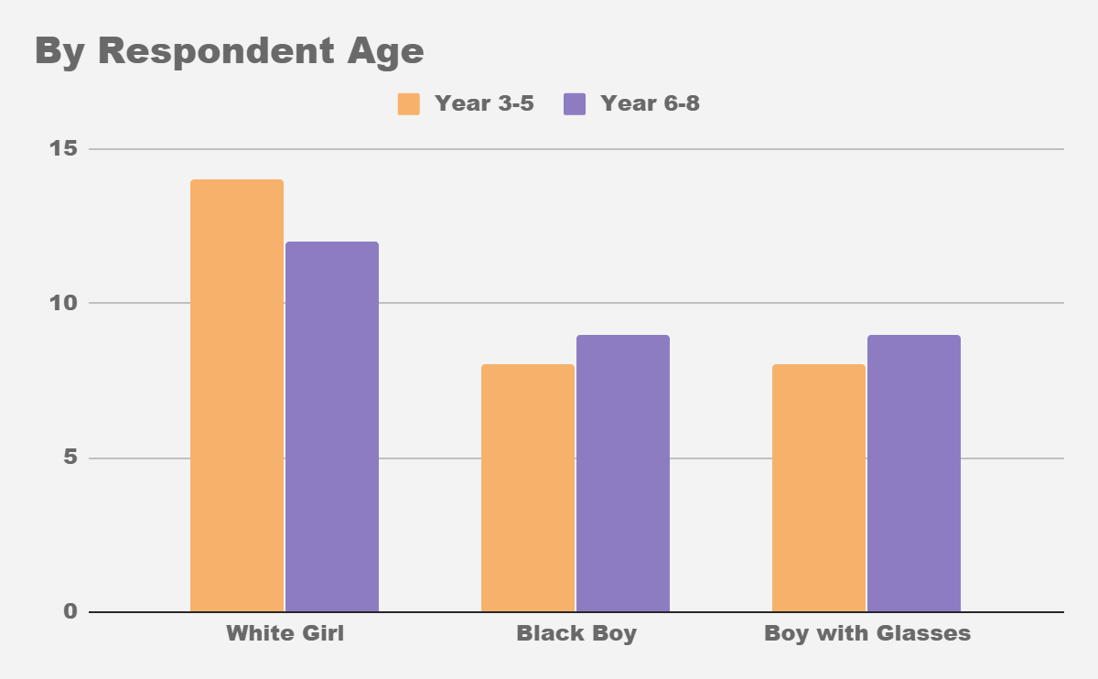
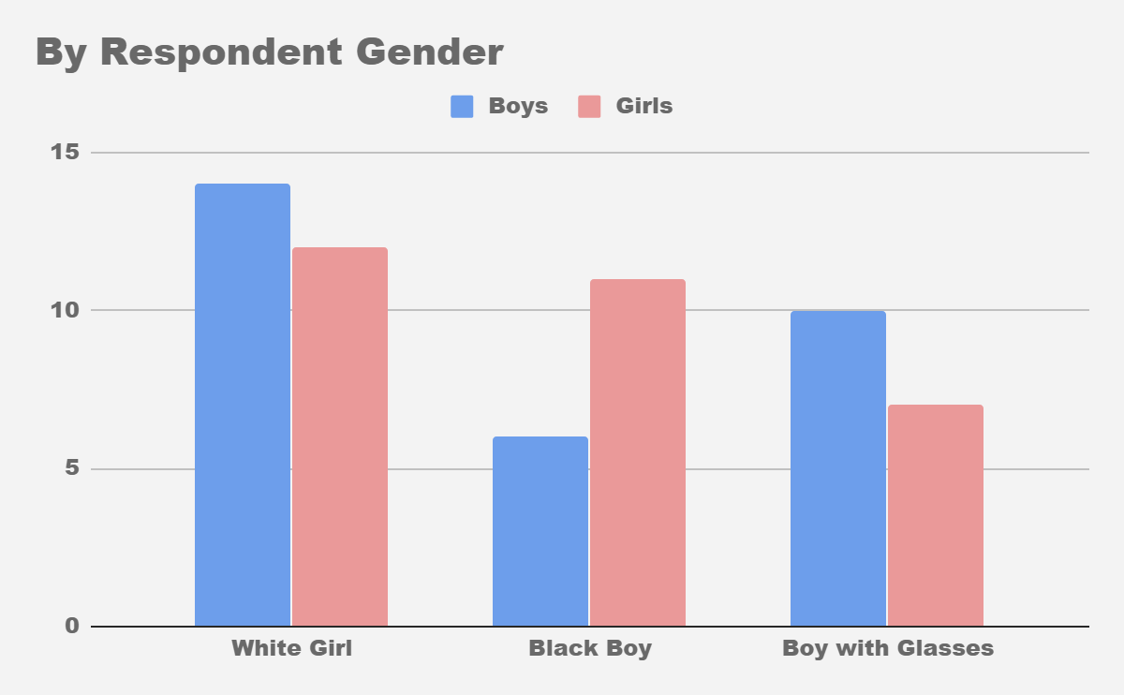
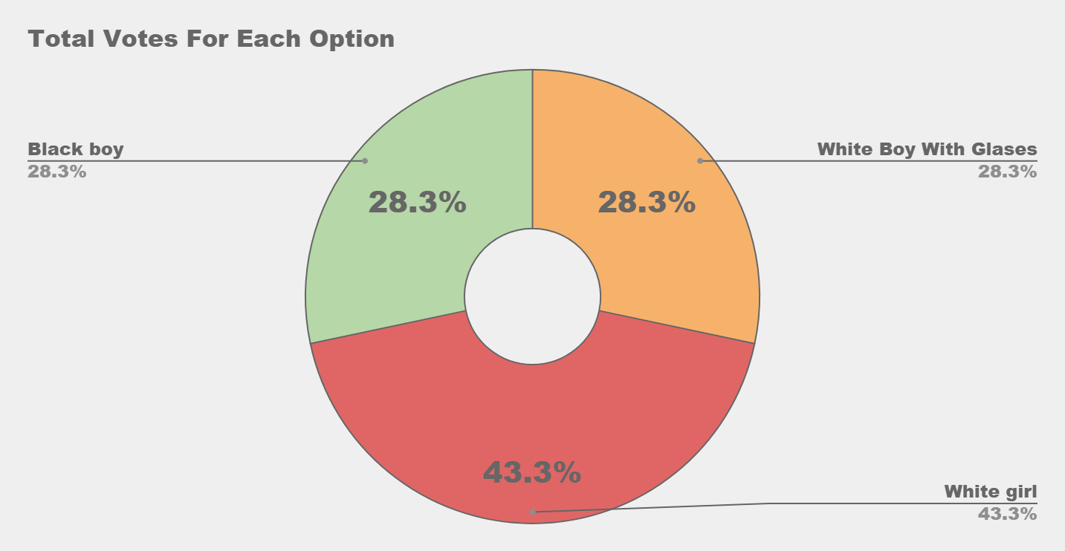
Summary
We tested 60 kids by showing them each a picture of a white girl, a black boy and a white boy with glasses. We asked them to pick which one was the ‘most different’ i.e. ‘who’s the odd one out?’ We compared votes from girls to boys and younger versus older to look for patterns
We tested 60 school students, 30 of each age group and 30 of each gender. The results are shown in these graphs.
The questions we were trying to answer
When presented with three equally different pictures might there be a bias toward picking one of the images if not given enough time to reason through the options? If so this could reveal a group bias toward one group of people. Furthermore, might there be a difference in age group - the idea being that younger kids might display more bias than older kids having not yet been educated about racial and gender equality. One member of the team initially proposed the idea and explained that they had observed society’s judgemental views and was inspired to conduct the tests.
Conclusion
We hypothesized that older kid votes would be evenly distributed between groups whereas younger kids would mostly pick the black boy. To our surprise, most chose the white girl among both age groups.
A possible explanation for this is that a difference in gender is viewed ‘more different’ than race because technically it actually IS more different from a purely genetic perspective. On the other hand, it is also possible that gender bias is in fact more entrenched than racial bias. We thought younger kids may be less ‘educated’ about tolerance toward people of the non-dominant ethnicity, but we found no evidence of this, which we found encouraging .
Recommendations/thoughts
To test this concept further we could develop a slightly different experiment. In this expansion we would make the dominant gender girls as opposed to boys. we have suspicions that potentially someone having glasses does not make them as much ‘The Odd One Out’ as someone with a different gender or race so in this new and improved experiment we would add a different characteristic such as braces or hair colour.
Why we decided to Produce a poster on this topic
We wondered if certain groups of people were perceived as being ‘more different’ than others solely based on their appearance. We were curious if there were patterns or bias towards people with different attributes. We decided to focus on: race, gender and accessories (specifically glasses).

