Slide 1
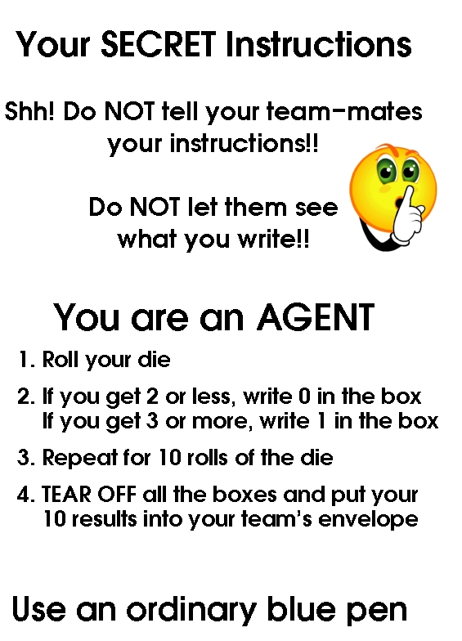
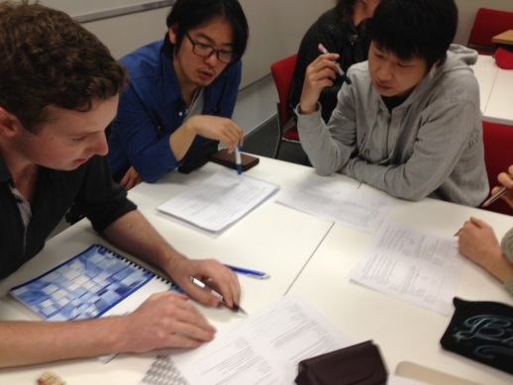
Teaching Statistics to Real People
Adventures in Social Stochastics
Rachel Fewster
Department of Statistics
University of Auckland, New Zealand

Slide 2
Stats 210: Statistical Theory
A first undergraduate course in probability and mathematical statistics
Approximately 100 students per class
Covers probability, random variables, hypothesis testing, maximum likelihood
Notes:
2

Slide 3
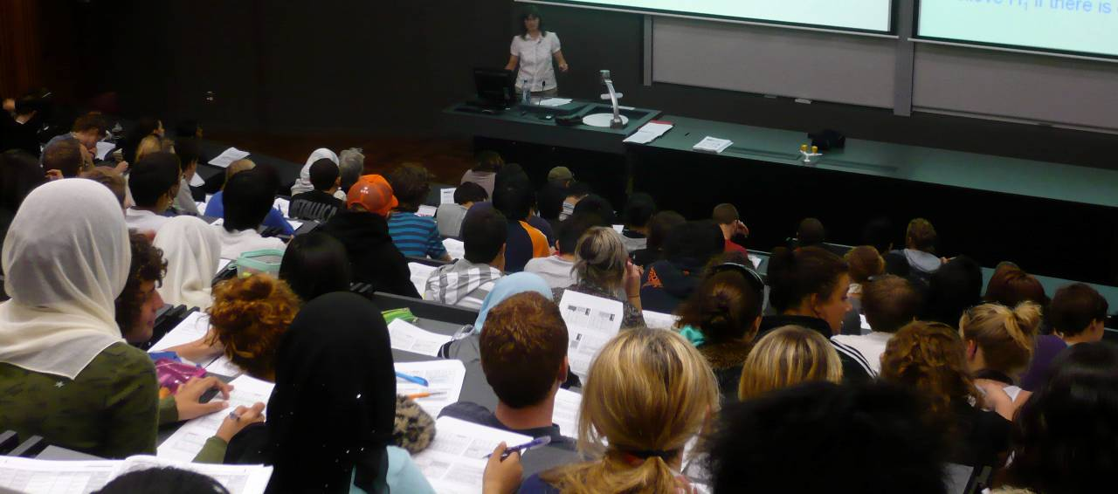
Diverse Intake
Notes:
3

Slide 4
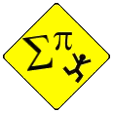
Diverse Intake
Attitudes to theory:
Notes:
4

Slide 5
The Challenge:
Theory lovers
Theory deniers
Make theory accessible & relevant
Fascinate & Inspire
Convert!
Notes:
5
?

Slide 6
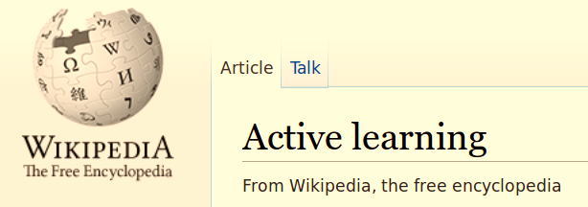
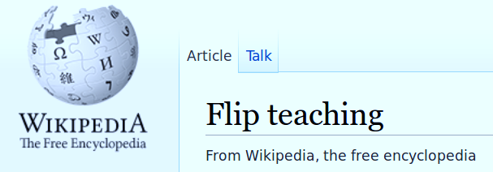
Everybody’s talking about ...
Notes:
6

Slide 7
Everybody’s talking about ...
At conferences...
In private vehicles...
In common rooms...
Notes:
7

Slide 8
Everybody’s talking about ...
In private vehicles...
Notes:
8

Slide 9
It’s got to be worth a try!
TEAM-BASED
LEARNING
Notes:
9

Slide 10
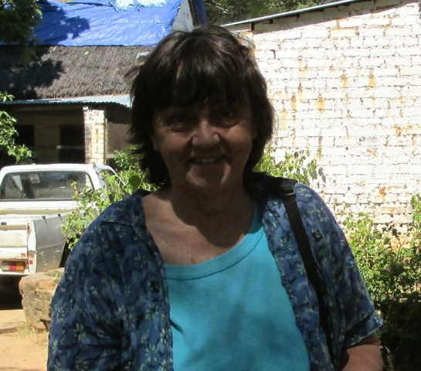
Credits
Dr Judy Paterson University of Auckland
Initiated, inspired, mentored, and supported throughout
Suggested the team-based learning framework
Notes:
10

Slide 11
Credits
Larry K. Michaelsen & collaborators Developed Team-Based Learning
Framework for peer-supported learning
Strong evidence-base for effectiveness in several tertiary disciplines
Still new in mathematical sciences
Notes:
11

Slide 12
Credits
Larry K. Michaelsen & collaborators Developed Team-Based Learning
System for peer-supported learning
Strong evidence-base for effectiveness in many tertiary disciplines
Still new in mathematical sciences
Using their ideas for design of teamwork sessions
Not using the full TBL structure of ‘flipped classroom’
Notes:
12

Slide 13
New Style for Stats 210
Was:
3 hours lectures + 1 hour tutorial / week
Now:
2 hours lectures + 1 hour tutorial
1-2 hours team sessions
Comfort Zone!

Slide 14
Team Sessions
Permanent teams of 5-6 students
Try to mix gender & ethnicity, but aim for fairly similar ability
Odd weeks: do Multi-Choice Quizzes
Even weeks: open-ended Team Tasks
Very nice design of team multi-choice sessions by Michaelsen et al
Creative engagement with mathematical statistics!

Slide 15
Aim Today
Good reasons to expect collaborative learning to be effective
Takes a lot of time to devise team activities
Share experience and materials
Collectively build evidence base
Notes:
15

Slide 16
Task 1: Probability
Notes:
16

Slide 17
Language
Symbols
Diagrams
$$P(A∩B)$$
$$P\left(A \right| B)$$
Notes:
17

Slide 18
Language
Symbols
Diagrams
This is how I think!
Notes:
18

Slide 19
Language
Symbols
Diagrams
This is how I do and discover
Notes:
19

Slide 20
Language
Symbols
Diagrams
This is how I communicate findings
Notes:
20

Slide 21
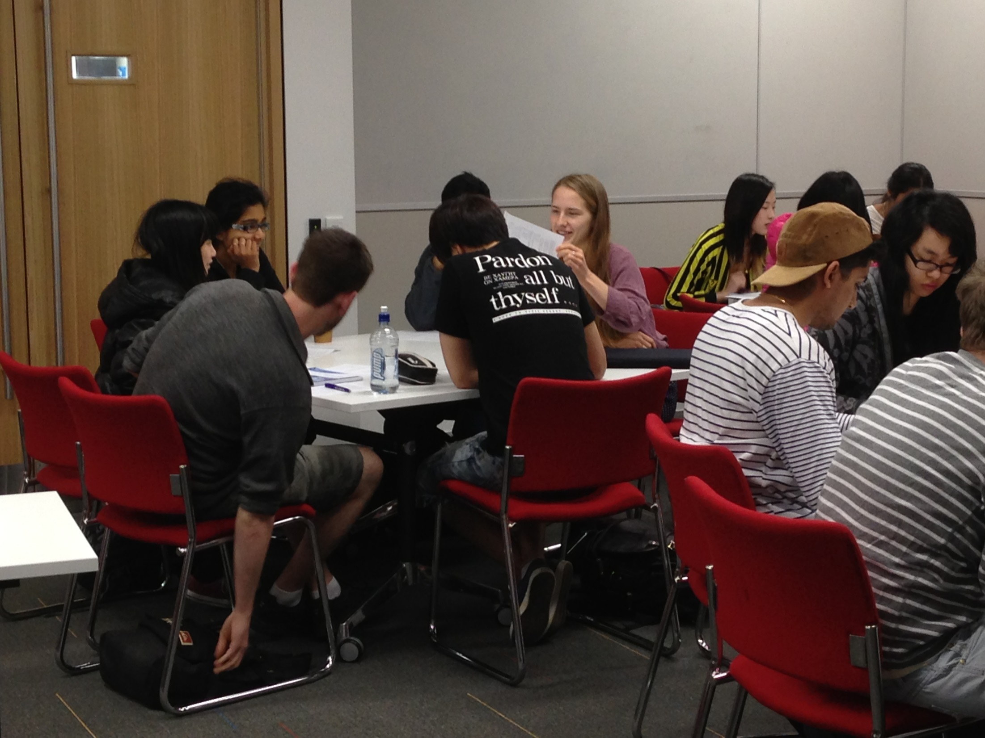
Natural to switch between representations in a social context
Notes:
21

Slide 22
Mr Tambourine runs Cafe Swan Cake:
an international musical coffee shop.
Sample space Ω = {customers}
Experiment: Pick a customer
Event I = {customer is Irish}
Event B = {customer plays the Banjo}
Given:
$$P\left(B \right| I)=0.4$$
$$P(B∩I)=0.2$$
Notes:
22

Slide 23
$$P\left(B \right| I)=0.4$$
$$P(B∩I)=0.2$$
Create two collections of sentences in natural language that express this information.
40% of the Irish customers play the banjo
20% of customers are Irish banjoists
Pick a customer: the chance of picking an Irish banjoist is 0.2
The probability of being a banjo-player is 0.4 for the Irish customers
Notes:
23

Slide 24
$$P\left(B \right| I)=0.4$$
$$P(B∩I)=0.2$$
Emphasizes the different sample spaces!
40% of the Irish customers play the banjo
20% of customers are Irish banjoists
Pick a customer: the chance of picking an Irish banjoist is 0.2
The probability of being a banjo-player is 0.4 for the Irish customers
Notes:
24

Slide 25
$$P\left(B \right| I)=0.4$$
$$P(B∩I)=0.2$$
Draw this information accurately on a diagram. Use areas to convey probabilities.
1.0
Event I must occupy half the area: P(I)=0.5
Ω
0.5
Ι
0.0
Notes:
25

Slide 26
$$P\left(B \right| I)=0.4$$
$$P(B∩I)=0.2$$
Draw this information accurately on a diagram. Use areas to convey probabilities.
$$P\left(B | I\right)=\frac{P(B∩I)}{P(I)}$$
1.0
Ω
0.5
Probability of B within I
is 0.4 ....
Ι
0.0
0.4
1.0
Notes:
26

Slide 27
$$P\left(B \right| I)=0.4$$
$$P(B∩I)=0.2$$
Draw this information accurately on a diagram. Use areas to convey probabilities.
1.0
Event B can be any height, as long as it occupies proportion 0.4 of I’s rectangle
Ω
Β
0.5
Probability of B within I
is 0.4 ....
Ι
0.0
0.4
1.0
Notes:
27

Slide 28
Contrast two diagrams in which B and I are respectively independent and non-independent.
1.0
Ω
Β
0.5
Proportion of B within I
is 0.4 ....
Ι
0.0
0.4
1.0
Notes:
28

Slide 29
Contrast two diagrams in which B and I are respectively independent and non-independent.
For independence, the proportion of B within Ω is the same as the proportion of B within I.
For independence ...
$$P\left(B | I\right)=P(B)$$
1.0
Ω
Β
0.5
Proportion of B within I
is 0.4 ....
Ι
0.0
0.4
1.0
Notes:
29

Slide 30
Contrast two diagrams in which B and I are respectively independent and non-independent.
For independence ...
1.0
Ω
Β
0.5
Proportion of B within I
is 0.4 ....
Ι
0.0
0.4
1.0
Notes:
30

Slide 31
Contrast two diagrams in which B and I are respectively independent and non-independent.
For independence ...
1.0
Ω
Β
0.5
Proportion of B within I
is 0.4 ....
Ι
0.0
0.4
1.0
Notes:
31

Slide 32
Contrast two diagrams in which B and I are respectively independent and non-independent.
Independent
Not Independent
Notes:
32

Slide 33
Lessons from Task 1
Can create ample opportunities for discussion from very simple scenarios
Challenged all students, including the best
Not everyone got the hang of the visual representations of conditional probability and independence, but...
... a breakthrough! Noticed a marked change in student behavior across the board for other problems : much greater tendency to draw diagrams
Doodle-ability!
Notes:
33

Slide 34
Lessons from Task 1
Can create ample opportunities for discussion from very simple scenarios
Challenged all students, including the best
Not everyone got the hang of the visual representations of conditional probability and independence, but...
... a breakthrough! Noticed a marked change in student behavior across the board for other problems : much greater tendency to draw diagrams
Can reinforce this new habit with explicit worksheet questions throughout the course
Notes:
34

Slide 35
Is visual probability useful?
Came upon the following problem soon after
Easily solved visually, clunky by algebra
$I_{1}, …,I_{n}$disjoint;
$$P\left(B \right| I_{1})= …=P\left(B \right| I_{n})=k$$
Is $P\left(B \right| {I_{1}∪…∪I}_{n})=k$ also?
Ι₃
$${I_{1}∪I_{2}∪I}_{3}$$
Β
Ι₂
Ι₁
Notes:
35

Slide 36
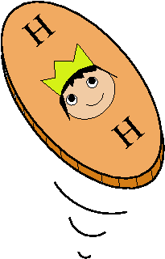
Task 2: Hypothesis Testing
We introduce hypothesis testing with a simple Binomial example:
Weird Coin !!
I toss a coin 10 times and observe 9 heads.
Can I continue to believe that the coin is fair?
Notes:
36

Slide 37
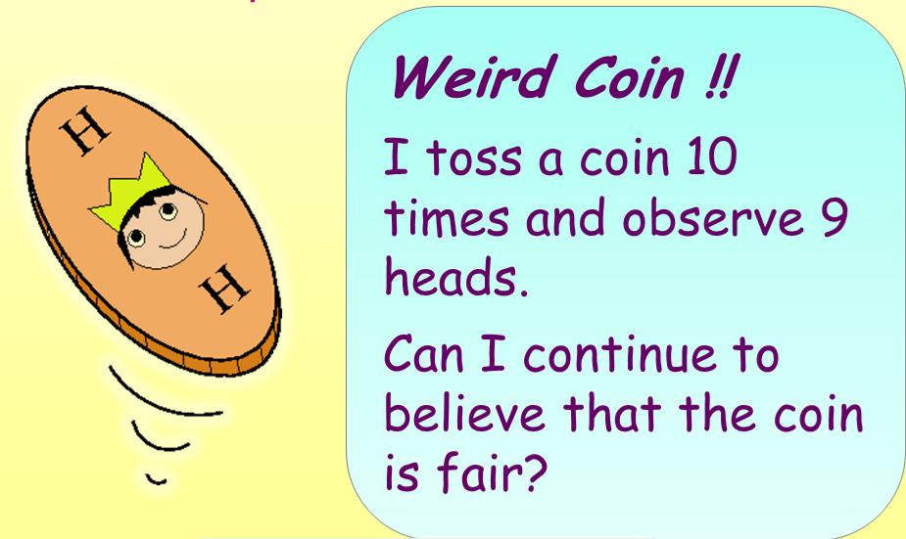
n, p₀ specified
X ~ Binomial (n, p)
H₀ : p = p₀
H₁ : p ≠ p₀
Notes:
37

Slide 38
Team activity
Do your own hypothesis test!
Only need a simple, engaging question with a disputable value of the Binomial p
Students should experience the data-collecting process:
Reinforces the idea of a population (data-generating mechanism) that we have to learn about through sampling
Notes:
38

Slide 39
A great idea!
Only need a simple, engaging question with a disputable value of the Binomial p
Buttered Toast:
Is it true that buttered toast tends to land on the carpet butter-side down? ☹
Notes:
39

Slide 40
Buttered Toast:
Is it true that buttered toast tends to land on the carpet butter-side down? ☹
Drop a piece of buttered toast n=20 times.
Let X be the number of times the toast lands butter-side down out of n=20 independent trials.
Under H₀, toast is equally likely to fall either way up
X ~ Binomial (20, p)
H₀ : p = 0.5
H₁ : p ≠ 0.5
Notes:
40

Slide 41
.........??
What was that about buttered toast?
Notes:
41

Slide 42
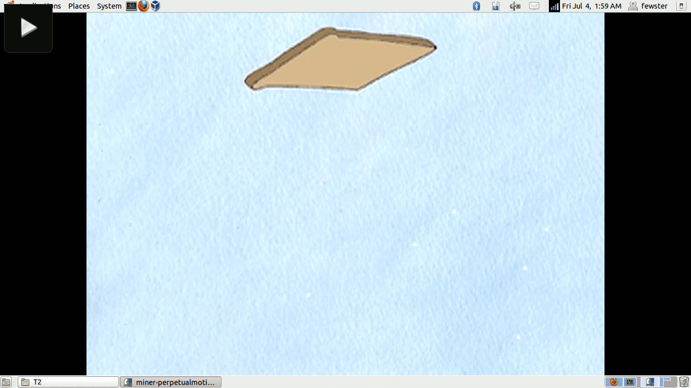
Artwork by Kimberly Miner via Youtube
Notes:
42

Slide 43
The doomed toast experiment
Used water bottles and marker pens, not butter!
Spent all week making toast
Asked students to consider the context: in what circumstances does this question become relevant?

Slide 44
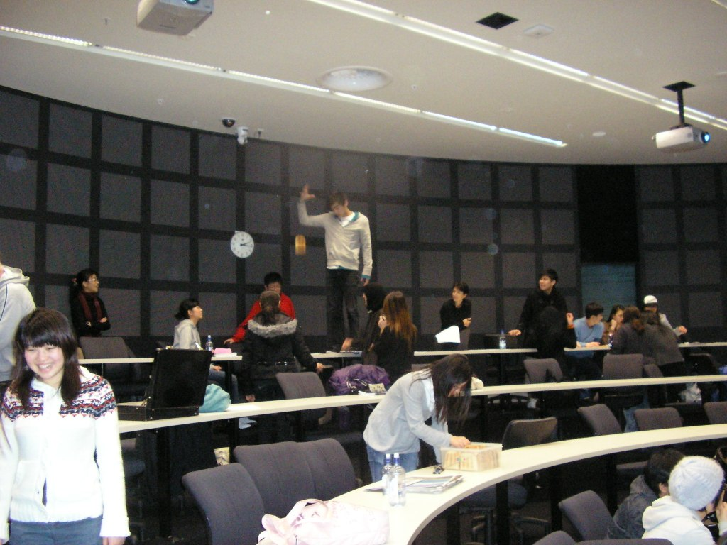
Toast!

Slide 45
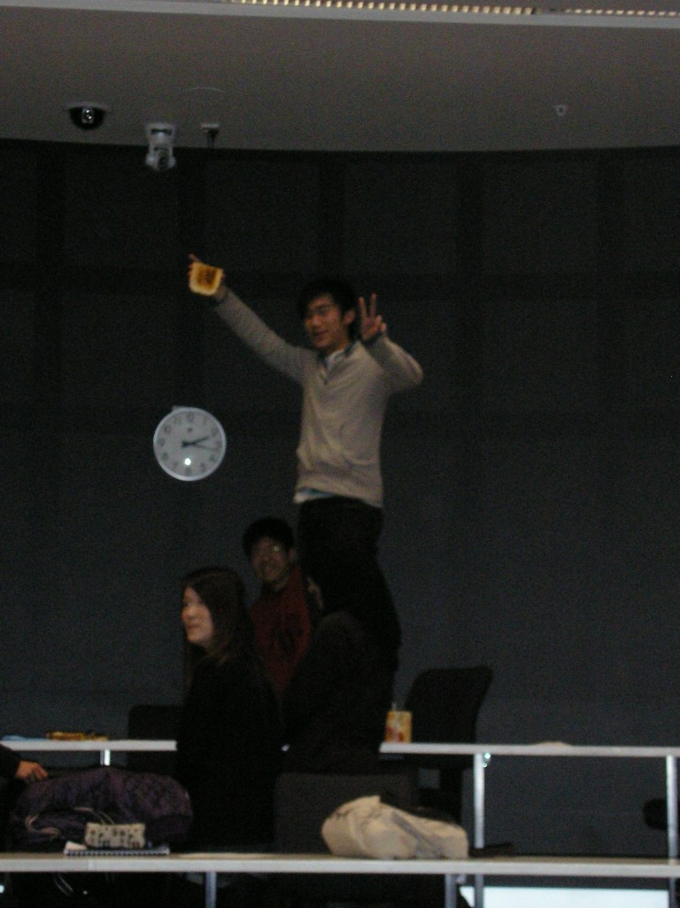
The most peculiar notion of ‘breakfast’ I have ever seen
2m

Slide 46
What happened?
Chaos!
Not very much statistical learning...
Notes:
46

Slide 47
What went wrong?
Yes, they should!
But if this phase is too distracting, the point of the exercise will be lost.
Notes:
47

Slide 48
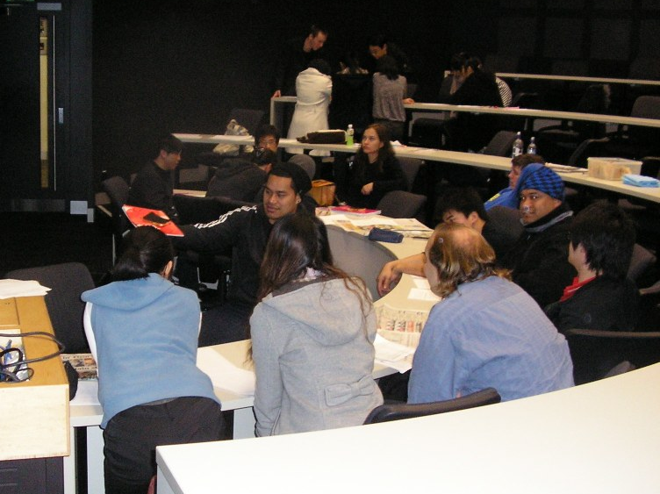
And anyway...
It’s actually quite boring, dropping toast.
Notes:
48

Slide 49
A new terminology for Statistical Education:
Too-Much-Toast (noun)
Definition: The art of missing the educational point due to an energy-consuming distractor
‘This exercise involves too-much-toast’
‘Refrain from putting too-much-toast into team activities’
Notes:
49

Slide 50
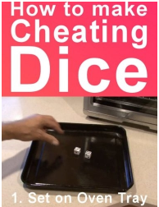
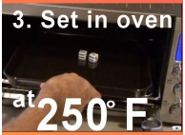
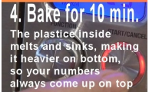
A better idea: Baked Dice
www.buzzfeed.com/koolnewsblog/how-to-bake-a-cheating-dice-1dgl
Notes:
50

Slide 51
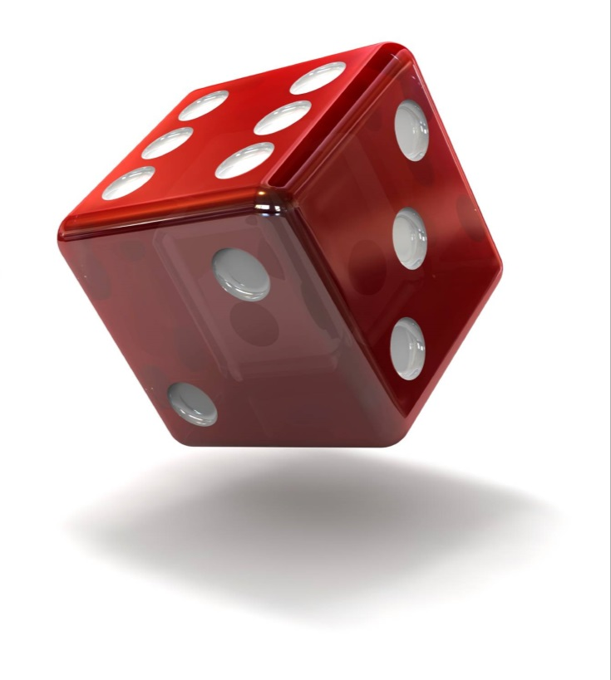
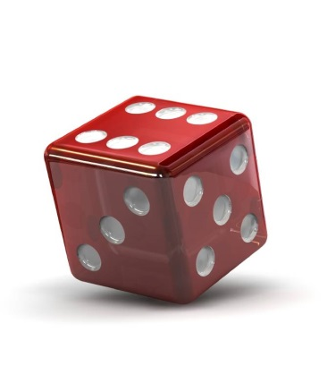
Baking dice to win every time?
Plastic melts and sinks
Dice are loaded in your favor!
Notes:
51

Slide 52
Baked dice hypothesis testing
I bake the dice at home beforehand (use adequate ventilation if trying this!)
Students just need to roll the dice and collect results

Slide 53
Baked dice hypothesis testing
Roll a baked die n=20 times:
X is the number of 6’s rolled.
Baking dice does not seem to work, but the activity is more successful!
X ~ Binomial (20, p)
H₀ : p = 1/6
H₁ : p ≠ 1/6

Slide 54
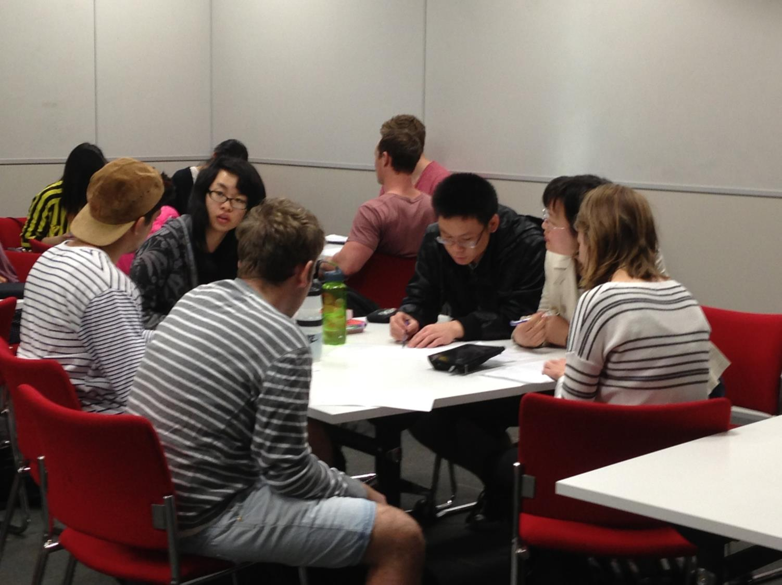
Aside: Where to do teamwork?
$$The Old…$$
$$…and the New$$
Moving to small, flat-floored seminar rooms made a big difference!
Notes:
54

Slide 55
Task 3: Movie Making!
Always wanted to get students to create dialogs as a way of understanding and engaging with course material
Problems: video cameras impractical; students don’t want to speak on record
New internet tools make it easy!
Any misunderstandings are spoken by cartoon characters, not by the students themselves!

Slide 56
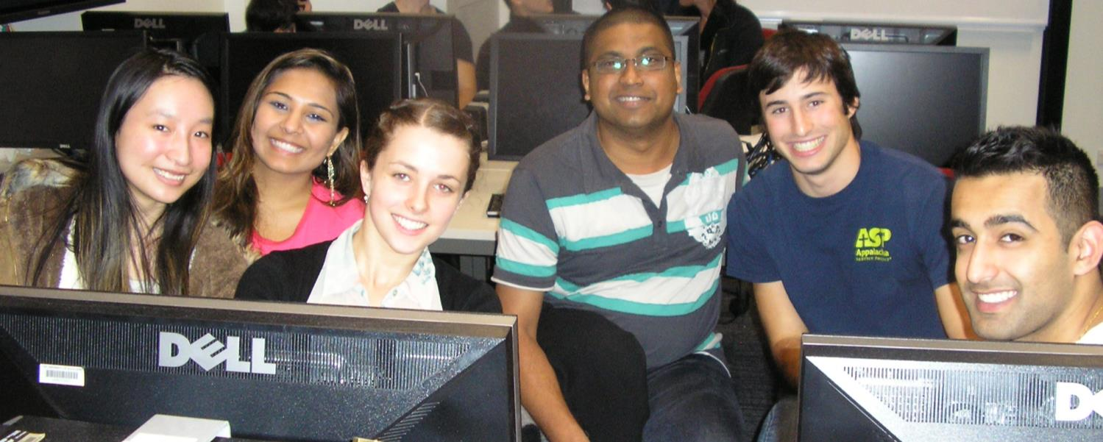
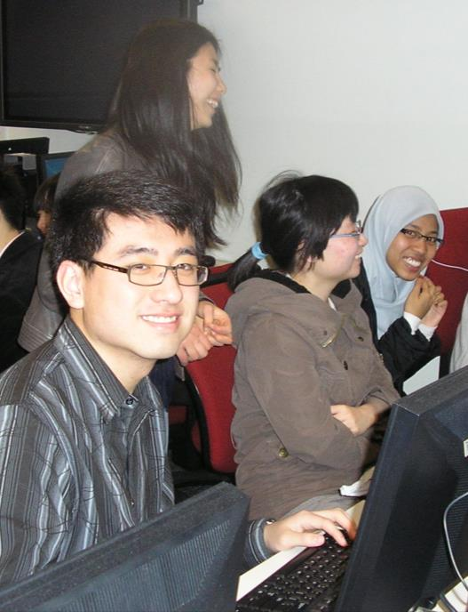
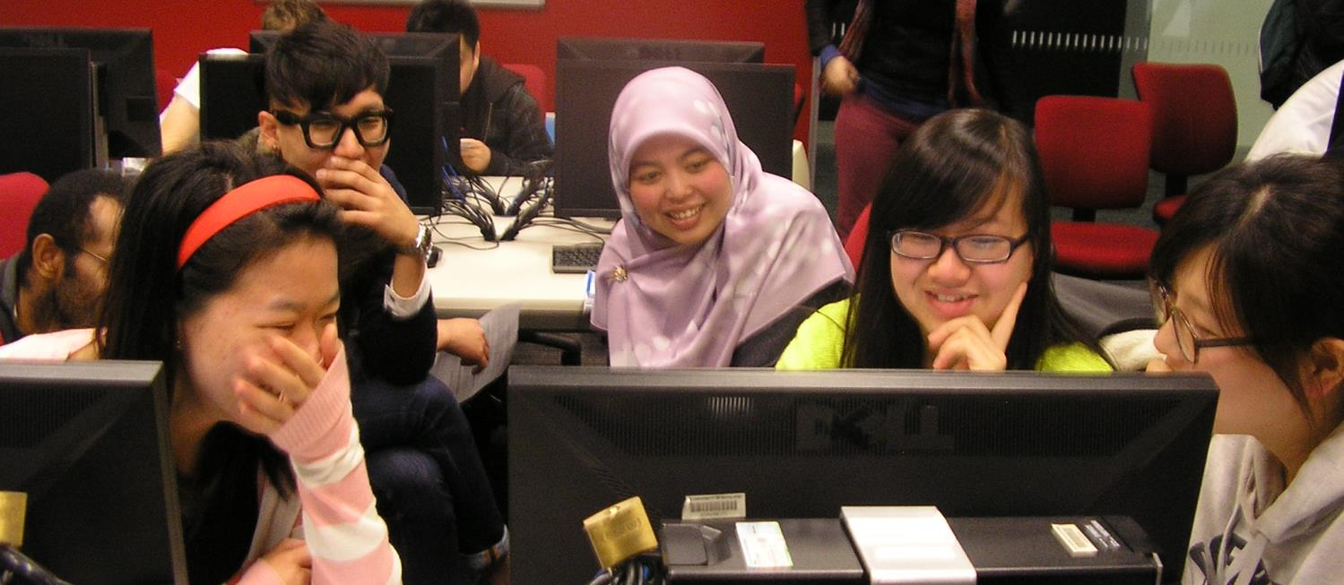

Slide 57
The Best Movie Ever Made
(in a statistics lecture)
Make a movie on a topic connected with sample size
Budget: $0
Time allowed: 1 hour
Falcon Team Video
Notes:
57

Slide 58
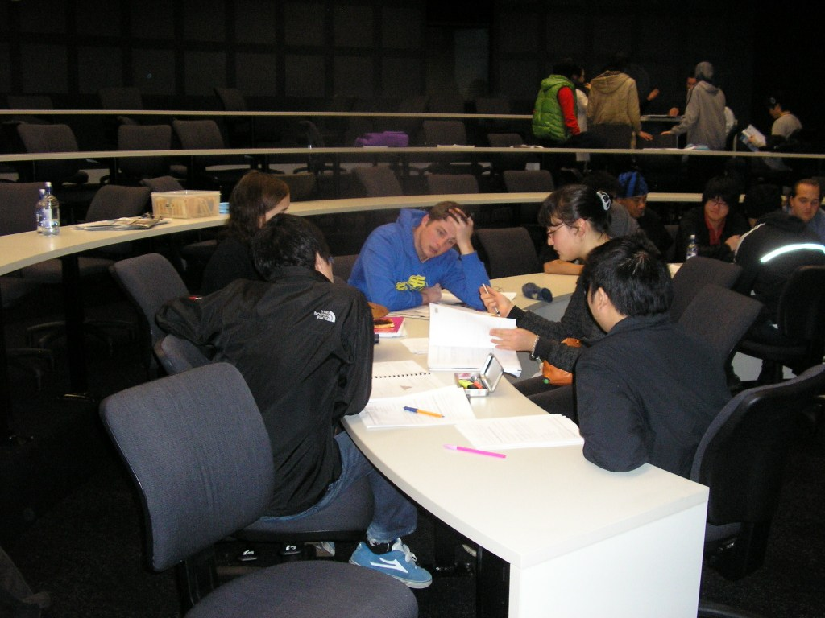
$$The Authors: Team Falcon$$
Toast!

Slide 59
Comments:
Some great movies, some fun movies, a couple of dull movies
Exposed some holes in understanding that I had never thought of:
before conducting a hypothesis test, you need a hypothesis!
Notes:
59

Slide 60
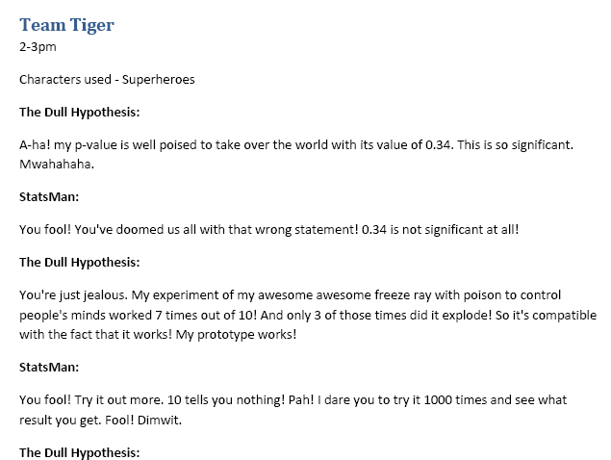
Hilarious script, but no hypothesis!
Seems to be implying H₀: p = 1 (the prototype ‘works’).
Several teams set up dialogs implying H₀: p = 1 or H₀: p = 0.
Notes:
60

Slide 61
Feed-through to exam:
Since the movie activity, exam questions on the effect of sample size on p-values have been superbly done (close to 100/100)
Students who don’t seem to be clear what a p-value is, nonetheless expertly address the matter of how it changes with sample size!
Previously had no end of difficulty with this topic!
Notes:
61

Slide 62
Exam Question
Airport security test: fake weapons planted on passengers, aim to find detection rate
Aim: P(weapon detected) = 0.8.
LAX: detected 72/100 weapons. Study concludes LAX is “well below target”
(a) Test H₀ : p = 0.8 for LAX; do you agree?
(b) Imagine a second trial with 720/1000 detections. How do the p-value and evidence compare with the first trial?
Notes:
62

Slide 63
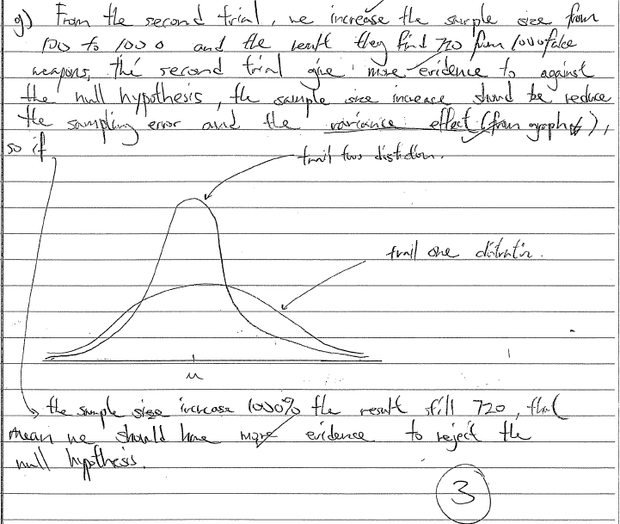
C– exam script
b) … the sample size increase should reduce the sampling error and the variance effect (from graph)
Trial 2 distn
Trial 1 distn
Chose to draw a diagram to illustrate point: legacy of Task 1!
Chose to use the technical term ‘variance’
Notes:
63

Slide 64
The word ‘variance’ was not mentioned in this context in any worked examples or solutions, but has suddenly become common on exam scripts.
Teamwork has empowered students to use technical language of their own accord?
Chose to draw a diagram to illustrate point: legacy of Task 1!
Chose to use the technical term ‘variance’
Notes:
64

Slide 65
Comments:
The movie didn’t attempt to EXPLAIN the problem-issue. So what did it do?
Make it about people?
Give it ‘student ownership’?
Create context, language, and incentive for private study?
Notes:
65

Slide 66
Task 4: Maximum likelihood
or: Catch the Spies!
We introduce maximum likelihood estimation with simple 1-parameter examples:
$X \sim \text{Binomial}\text{(}n, p)$ $(n \text{is} \text{known}\text{)}$
$\text{Observe} X=x$
$MLE is \hat{p}=\frac{x}{n}$

Slide 67
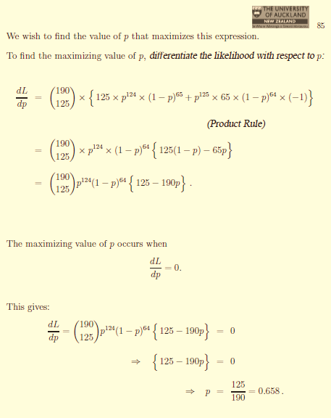
A lot of work for an obvious answer!
Try something 190 times and see 125 successes.
Do lots of calculus...
...finally estimate success probability is 125/190 (!)

Slide 68
Task 4: Catch the Spies!
Creates a classroom game for a more subtle application of maximum likelihood estimation
Students are given Secret Instructions as they arrive at class
Some students are ‘spies’, others are ‘agents’

Slide 69
Task 4: Catch the Spies!
Creates a classroom game for a more subtle application of maximum likelihood estimation
Students are given Secret Instructions as they arrive at class
Some students are ‘spies’, others are ‘agents’
Spies and agents complete 10 missions each, with different success probabilities
Aim is to use the data of overall number of successful missions, to estimate the number of spies in the team!

Slide 70
Agent Instructions
Agents work hard and are successful at 2/3 of their missions...

Slide 71
Spy Instructions
Spies get distracted and are successful at only 1/3 of their missions...

Slide 72
P(1)=1/3
Spy
0
0
1
1
0
0
0
1
0
1
P(1)=2/3
Agent
1
1
0
1
1
0
0
1
1
1
Notes:
72

Slide 73
Tear off boxes and mix all together...
0
0
1
1
0
0
0
1
0
1
1
1
0
1
1
0
0
1
1
1
Notes:
73

Slide 74
The Data!
Each 1 is from:
Spy (probability $s$ )
Agent (probability $1−s$)
0
0
1
1
0
0
0
1
0
1
1
1
0
1
1
0
0
1
1
1
Notes:
74

Slide 75
Each 1 is from:
Spy (probability $s$ )
Agent (probability $1−s$)
$$P\left(1\right)=\frac{1}{3}s+\frac{2}{3}(1−s)$$
P(success | spy) = 1/3
P(success | agent) = 2/3
Notes:
75

Slide 76
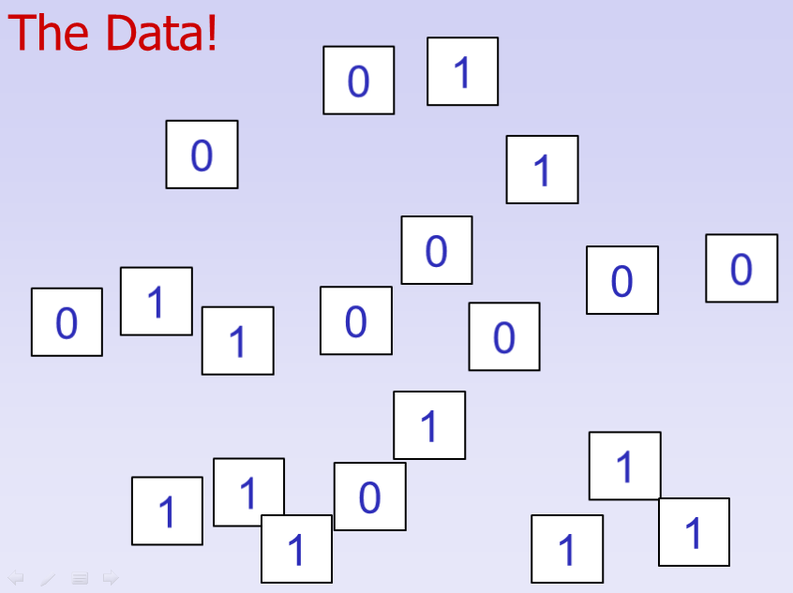
$n$ players
$10n$ data (0 or 1)
Proportion$\text{s}$ are spies
Proportion $(1−s)$ are agents
$X=$ $\text{\#}\text{successes} \text{in} 10n \text{trials}$ $X\sim \text{Binomial}\left(10n, \frac{1}{3}s+\frac{2}{3}\left(1−s\right)\right)$
Count the number of 1s, formulate Binomial likelihood, and maximize it to estimate $s$
Notes:
76

Slide 77
Found maximum likelihood estimate of $s$ ...
Confession time!
All team members confess their status to teammates
Calculate the true value of $s$ (proportion of spies in the team)
Compare the MLE to the true $s$
Notes:
77

Slide 78
Outcome
Previous version was more complicated and not successful; this version works well
Mostly get good estimates of $s$
Students enjoy the game of uncovering illicit information about team members
Students appreciate seeing a more subtle application of maximum likelihood estimation

Slide 79
Quite impressive to deduce spy composition from the 0-1 data!
Notes:
79

Slide 80
Further Unexpected Outcome
Activity was the basis of the hardest exam question (students notified in advance)
Exam question was identical in statistical structure, but very different in context:
Apples being treated against ‘scald’
Treatment process is not working properly
Proportion $s$treated: $P(\text{scald}\text{ | }\text{treated}\text{) = 1/5}$
Proportion $1−s$ failed:$P(\text{scald}\text{ | }\text{failed}\text{) = }\text{3}\text{/5}$
Exam Q much harder and deeper than team activity: find MLE for $s$; find estimator variance; compare different estimators for $s$

Slide 81
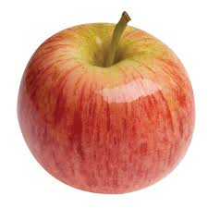
Each apple with scald is:
Treated (probability $s$ )
Untreated (probability $1−s$)
$$P(\text{scald})=\frac{1}{5}s+\frac{3}{5}(1−s)$$
P(scald | treated) = 1/5
P(scald | untreated) = 3/5
Notes:
81

Slide 82
Each apple with scald is:
Treated (probability s)
Untreated (probability 1-s)
Data are #apples with and without scald
$$P(\text{scald})=\frac{1}{5}s+\frac{3}{5}(1−s)$$
P(scald | treated) = 1/5
P(scald | untreated) = 3/5
Notes:
82

Slide 83
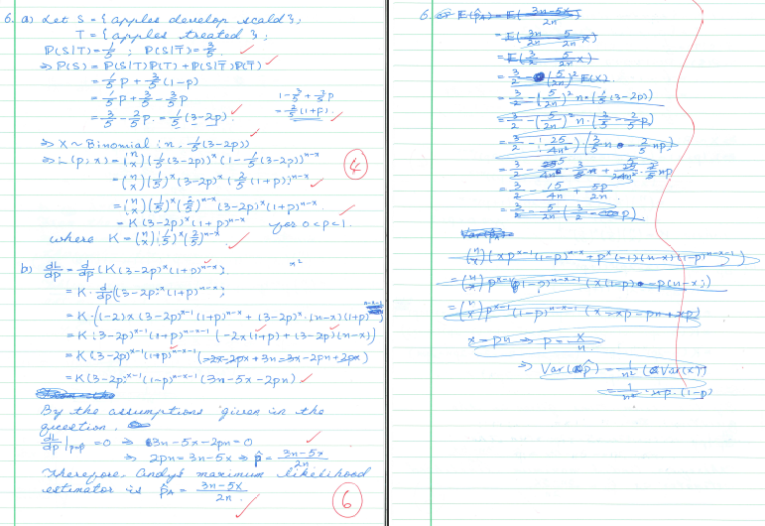
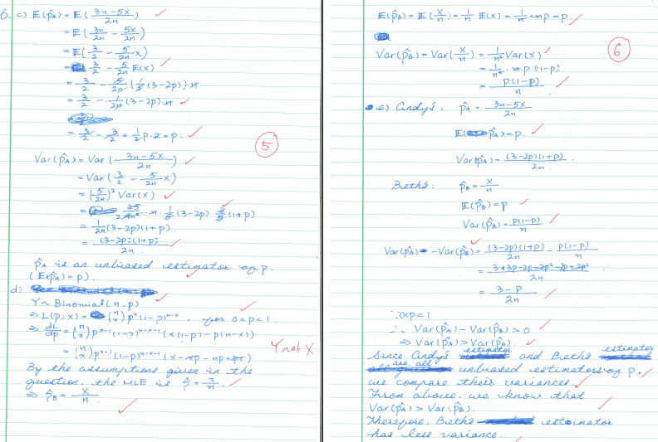
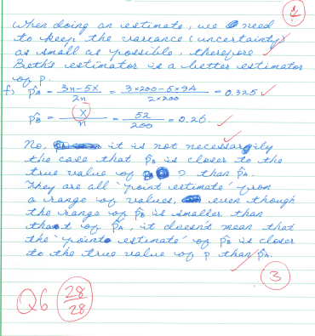
Notes:
83

Slide 84
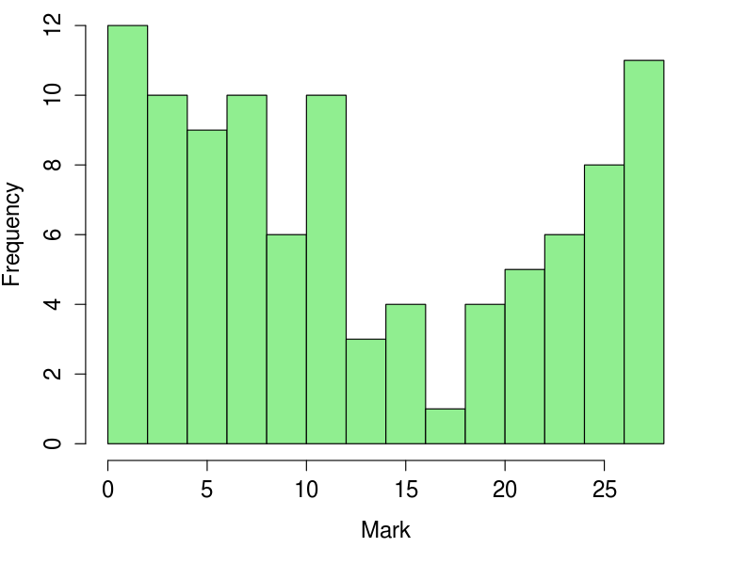
Exam Q incredibly well done
Expected 10-15% high-quality answers
Got 35% !
35%

Slide 85
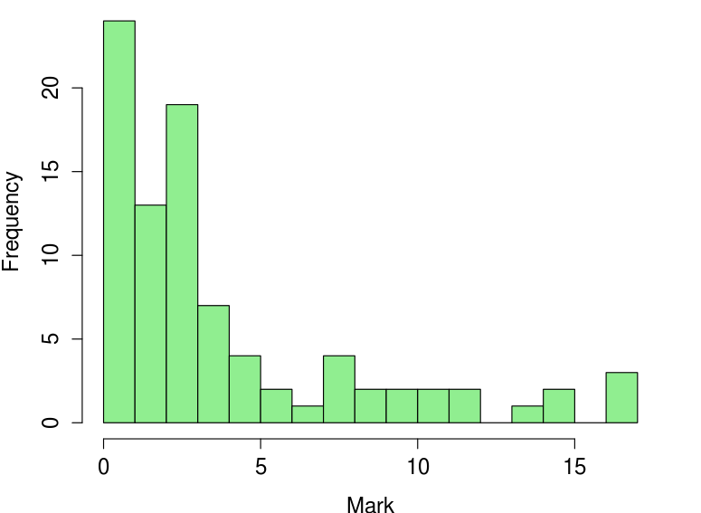
Contrast with previous effort
Similar setup: hard exam question based on previous more-complicated team exercise
Students notified it would be on exam
12%

Slide 86
Comments
Surprised at how well the Spies students did (similar result obtained the next year)
Students didn’t report the exam was easy: “fair”, or “doable if you thought about it”
Thought with what?
Did the team activity act as an enabler?
Turned an abstract problem into a real-world experience?
Provided seed and incentive for private study?

Slide 87
Comments
Anectodal, but promising result – needs proper study!
Some students concertedly studied the statistical structure of this example prior to the exam: set out to make the concrete problem abstract
Surprised at how well the Spies students did
Students didn’t report the exam was easy: “fair”, or “doable if you thought about it”
Thought with what?
Did the team activity act as an enabler?
Turned an abstract problem into a real-world experience?
Provided seed and incentive for private study?

Slide 88
Comments
Warning! Could work in the reverse direction too?
Team activity that doesn’t go down well may supply disincentive and demotivate private study?
Surprised at how well the Spies students did
Students didn’t report the exam was easy: “fair”, or “doable if you thought about it”
Thought with what?
Did the team activity act as an enabler?
Turned an abstract problem into a real-world experience?
Provided seed and incentive for private study?

Slide 89
Overall Summary: student perspective
Students mostly like the team activities
Especially like the MIX of activities: traditional lectures, marked tutorials, teamwork, plus homework assignments
Many didn’t expect to like it, but became converts

Slide 90
Evaluation comments
Team work (29)
Tutorials (14)
Coursebook
Lectures
Recorded lectures
Assignments
Mix of activities
MathsTutor / Extra
IIIIIIIIIIIIIIIIIIIIIIIIIIIII
IIIIIIIIIIIIII
IIIIIIIIII
IIIIIIIIII
IIIIIIII
IIIIIII
IIIII
IIIII
All items with more than one response featured
Notes:
90

Slide 91
Evaluation comments
Would like mid-term Test
Remove / improve teamwork
Would like more lectures
IIIII
III
III
All items with more than one response featured
Notes:
91

Slide 92
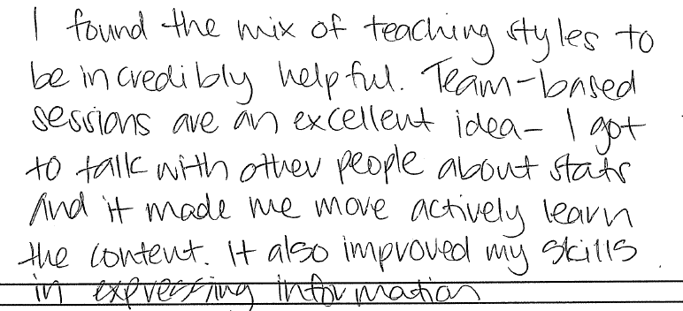
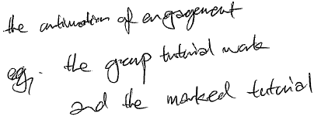
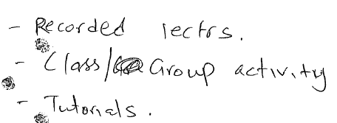
Notes:
92

Slide 93
Notes:
93

Slide 94
Overall Summary: student perspective
Some academic high-achievers don’t shine in the team / creative environment
can create discontent where there was none before
But other students unexpectedly come into their element – let’s give them this experience!
Suspect students don’t recognize how much team collaboration has contributed

Slide 95
Overall Summary: my perspective
Rewarding, eye-opening
new insights into gaps in understanding, e.g. before you do a hypothesis test, you need a hypothesis!
Time-consuming!
Thanks to our tolerant families!

Slide 96
Overall Summary: my perspective
Aim today is to encourage sharing of ideas and materials:
collectively build evidence-base specific to Statistics
Rewarding, eye-opening
new insights into gaps in understanding, e.g. before you do a hypothesis test, you need a hypothesis!
Time-consuming!
Would have liked to assess effectiveness through proper study, but implementation alone took too much time

Slide 97
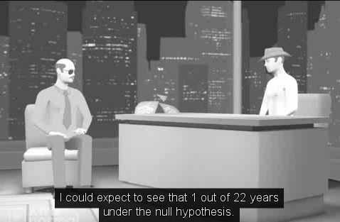
Conjectured Triumphs
Expanding the ways students think about and relate to the subject matter:
New interest in visual thinking after Task 1
Embracing the material into their own culture in Task 3
Enabling effect for private study from Task 4

Slide 98
Overall Summary: my perspective
The experience also rekindled my enthusiasm for traditional delivery – lectures!
If they are valued, they are valuable!

Slide 99
Overall Summary: my perspective
The experience also rekindled my enthusiasm for traditional delivery – lectures!
Believe the winning approach is a mix of activities
My experiences agree with other studies:
Teamwork improves critical and creative thinking
Doesn’t make much difference to drill-and-practice-style mathematical exercises

Slide 100
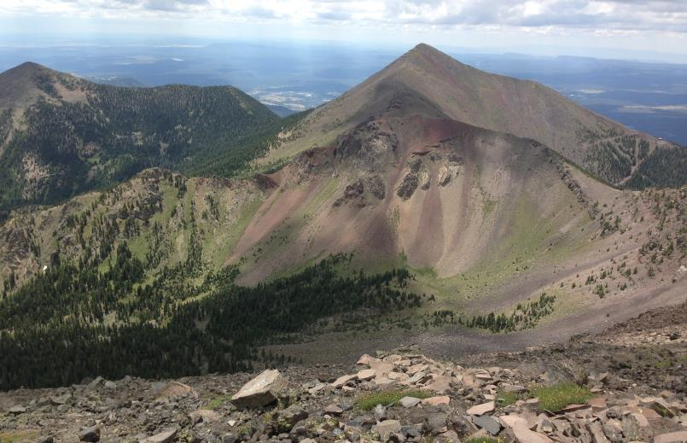
Thank you!
Special thanks to:
ICOTS Organisers!
Stephanie Budgett & Jessie Wu in-class helpers and advisors
Joss Cumming, Mike Forster, Christine Miller, Ross Parsonage, Maxine Pfannkuch, Matt Regan, David Smith, Chris Wild, & Ilze Ziedins my team of peer teachers!

Slide 101
Extra Slides
Notes:
101

Slide 102
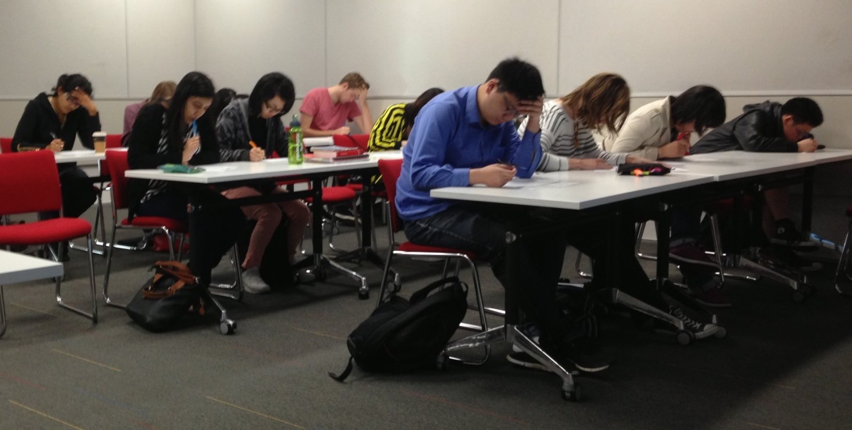
Multi-Choice Quizzes
following Michaelsen et al
First do the quiz individually (20-25mins)

Slide 103
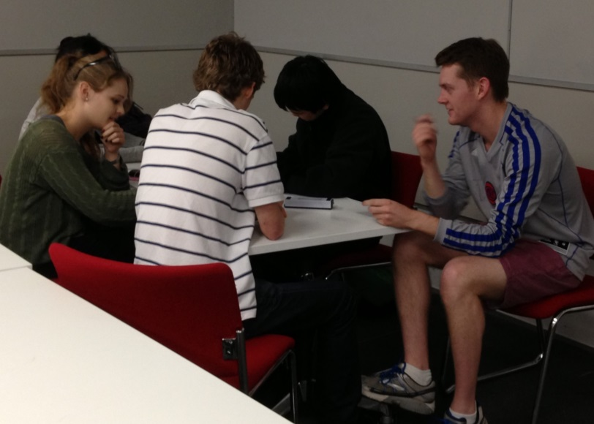
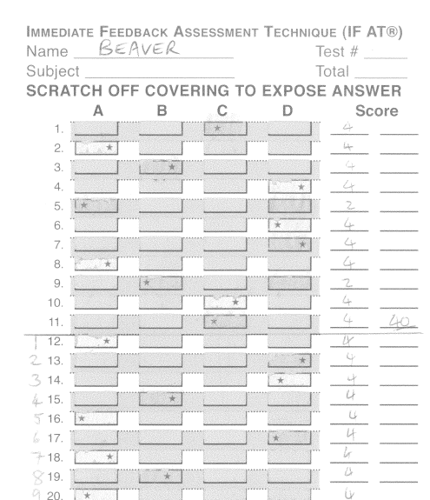
Multi-Choice Quizzes
following Michaelsen et al
Then REPEAT the quiz with teammates

Slide 104
Scratch & Win Statistics
Right 1st try: 4 marks
2nd try: 2 marks
3rd try: 1 mark

Slide 105
Scratch & Win Statistics
Right 1st try: 4 marks
2nd try: 2 marks
3rd try: 1 mark
Immediate feedback on right / wrong
Must keep going until correct
Shifts focus from ‘getting a mark’ to understanding right & wrong arguments
Focus on concept, not calculation

Slide 106
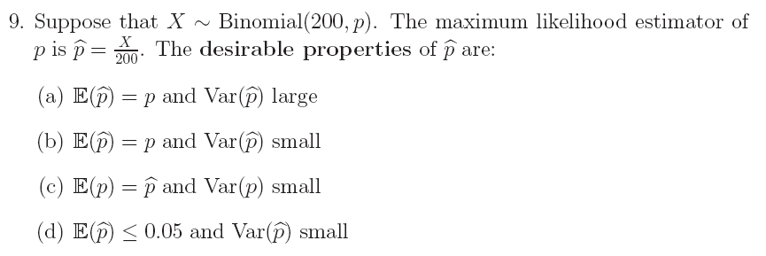
Concept, not calculation
Tests more content, and in different ways
– details of notation
– concepts we assume are picked up but often aren’t
Some Qs don’t tell # of MC answers correct

Slide 107
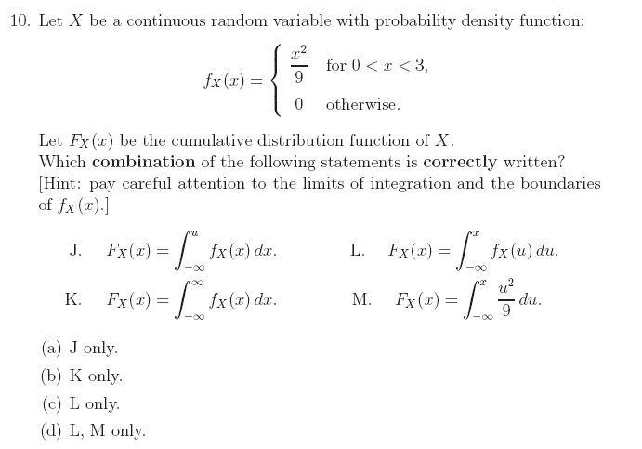

Slide 108
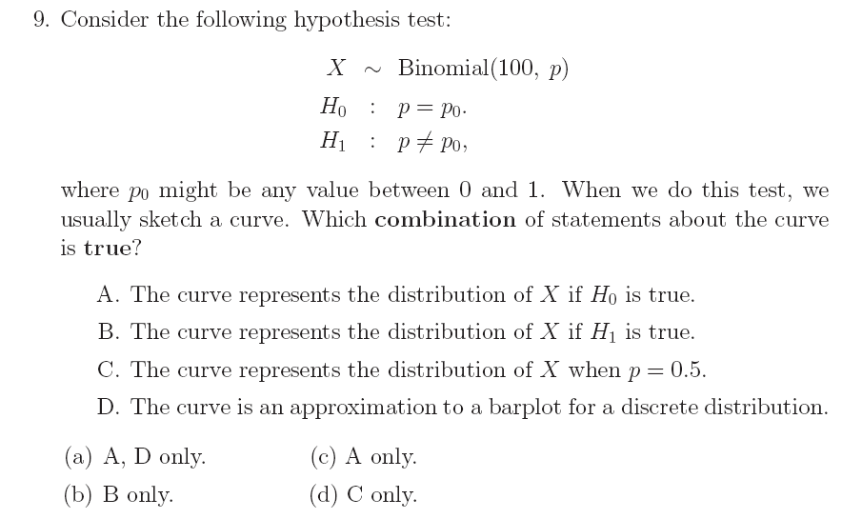

Slide 109
Overall Summary: student perspective (extra slide)
Some say they like Tasks or Multi-Choice Quizzes, but not the other (roughly even split)

Slide 110
Thoughts on Flipping the Classroom
What I would have said about this experience if asked:
I like the principle, but it didn’t work well for me & my students.
Need a strong personality and rigid structures to force students to do the extra reading: they have many demands on their time.
Risks damaging friendly relations with students, especially if they don’t see the point.
But being too gentle (as I was) means they don’t do the reading.
Notes:
110

Slide 111
To Flip,
or Not To Flip?
‘Flipping the Classroom’ means students read the coursebook in their own time; do problems & think during lecture time
Attempted flipping at first
Gradually gave up – hard (for me) to cover material & to get students to self-study
Rekindled my enthusiasm for traditional lectures: if they are valued, they are valuable
Notes:
111

Slide 112
To Flip,
or Not To Flip?
‘Flipping the Classroom’ means students read the coursebook in their own time; do problems & think during lecture time
Try Flipping again eventually?
Innovate gently!
Notes:
112

Slide 113
Extra slides about movie-making (Task 3)
Notes:
113

Slide 114
Comments:
How to exemplify the possibilities without stifling creativity?
Without exemplars, got some brilliant results and some humdrum results
With the Falcon exemplar, all the movies were good – but they were statistical clones of Falcon’s idea!
Exemplify using a different topic or medium (e.g. comic strip versus movie?)
Notes:
114

Slide 115
Now for the bad news...
The movie-making website (xtranormal) closed down in 2013
Recently acquired by a new company: might soon be restored to previous glory? (Details currently unclear)
Several alternatives, including online tools for making movies, comic strips, and more: GoAnimate (not free); Plotagon; PowToon; Pixton; more appearing all the time!
Notes:
115

Slide 116
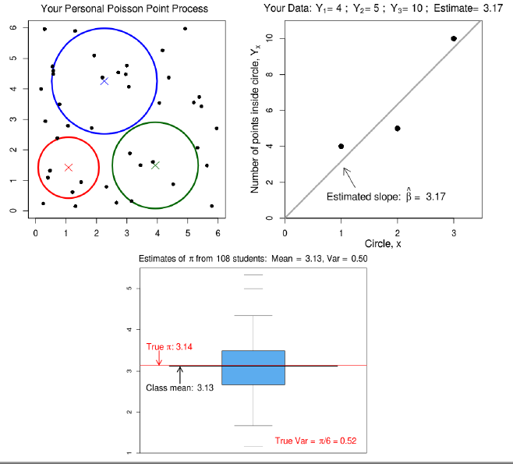
Task 5: Poisson Regression
Details in Conference paper

