Slide 1
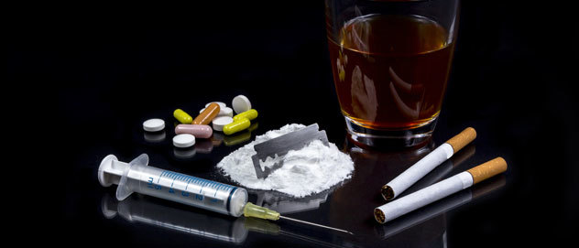
Playing Drug Impression : Case of secondary schools- South Africa
Nyaope (Local Mixture)
Patje (Marijuana)
Man drugs
Cigarettes
Drugs : substance that cause physiological effect
What if is addiction
DRUG TYPE | % DRUG ABUSE BY PROVINCES :SOUTH AFRICA
 | EC | KZN | WC | GP | MP | LP | FS | NC | NW | TOTAL
Alcohol | 45 | 39 | 30 | 47 | 42 | 61 | 67 | 65 | 63 | 51
Cannabis | 18 | 17 | 13 | 19 | 40 | 14 | 17 | 27 | 24 | 21
Cannabis/mandrax | 8,5 | 0 | 3 | 2 | 0 | 0 | 1 | 1 | 0 | 1,7
Crack/cocaine | 20 | 9 | 4 | 14 | 7 | 16 | 10 | 1 | 5 | 9,6
Heroin/opiates | 4 | 32 | 14 | 10 | 7 | 2 | 1 | 2 | 0 | 7,9
Drug education and advocacy
Source: Epidemiology of drug abuse treatment in South Africa ,2010

